Slide 1
Care Website
(Semester: DISM)
Batch Code: 2211B2
Faculty: Miss Bakhtawar Siraj
Co-Ordinator: Miss Munazzah Khan
Curriculum code: 7062

Slide 2

Sides/Panels of Website
Admin Panel
Doctor Panel
User Side

Slide 3
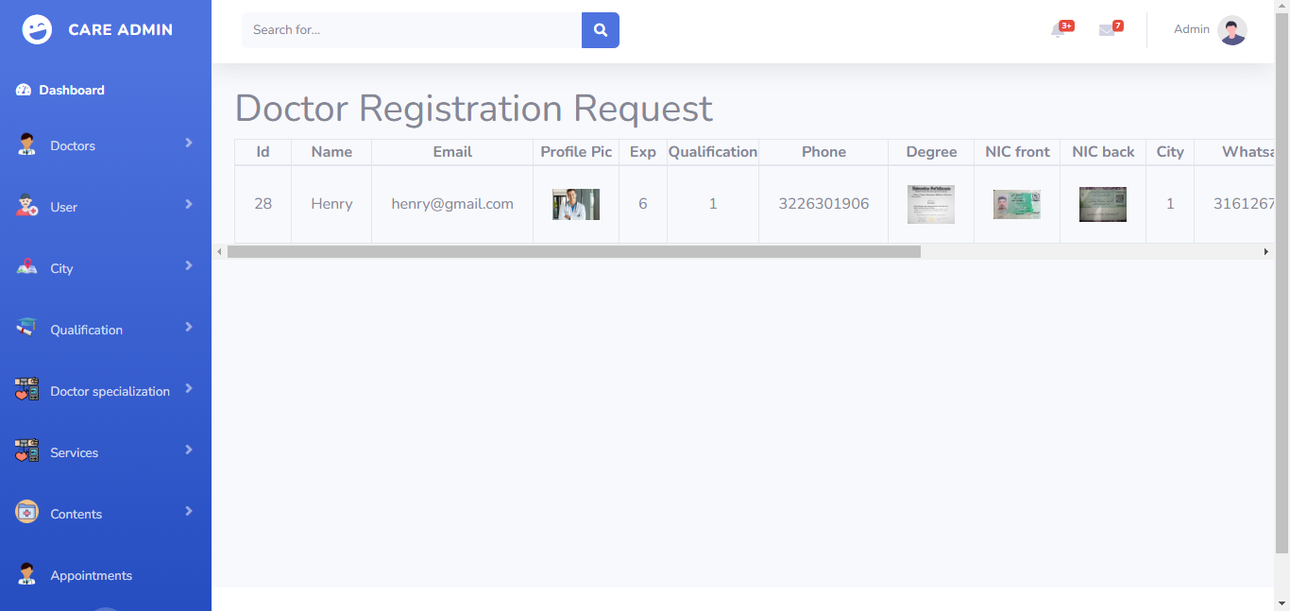
Admin -> Doctor Registration Request

Slide 4
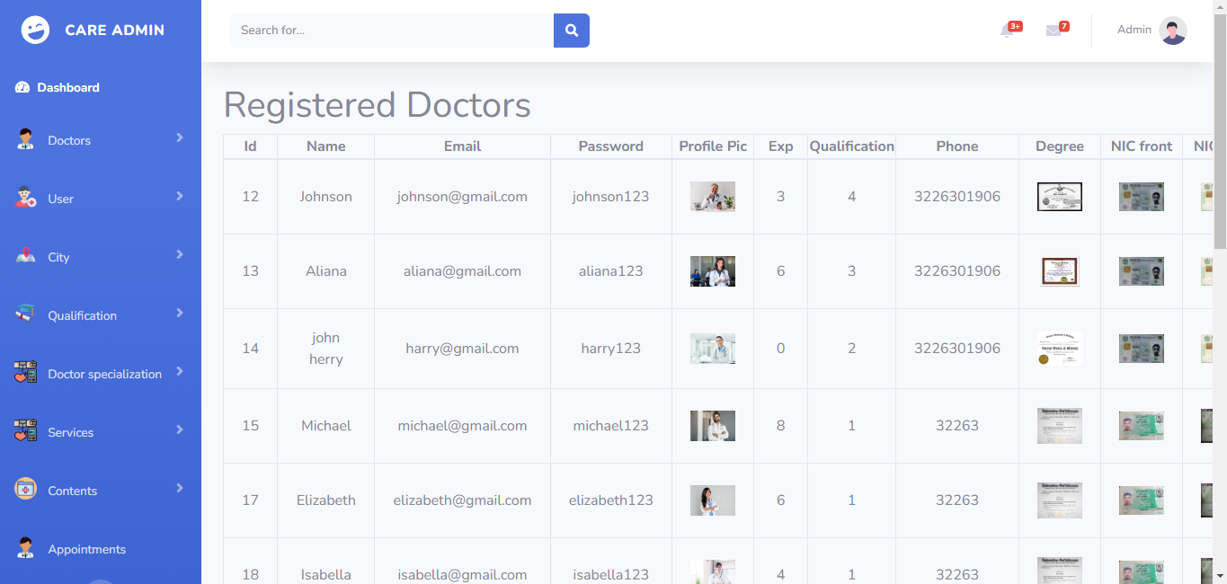
Admin -> Registered Doctors

Slide 5
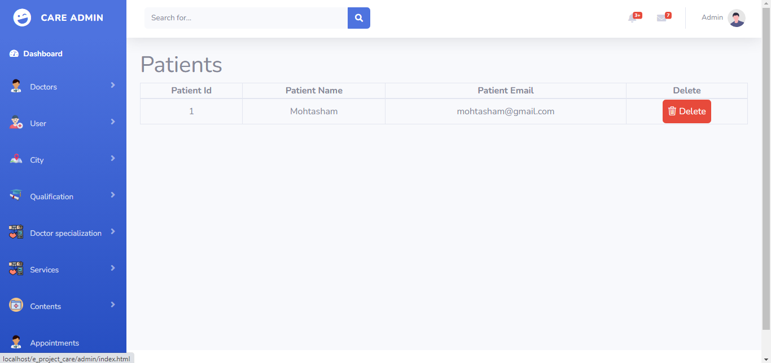
Admin -> Registered Patients

Slide 6
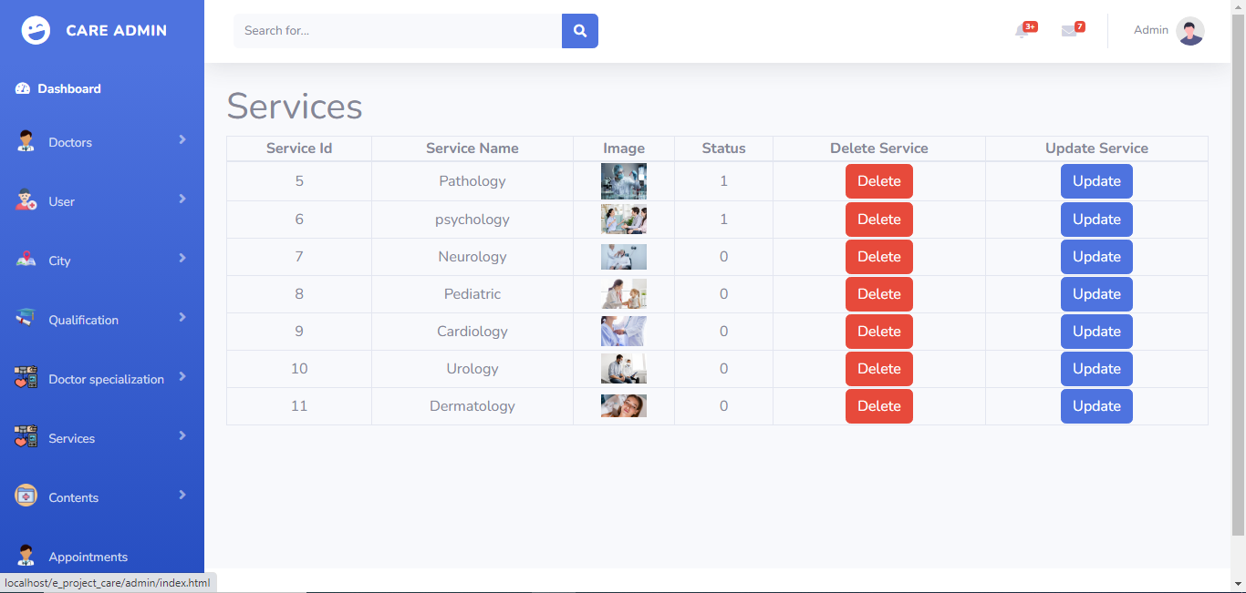
Admin -> Our Services

Slide 7
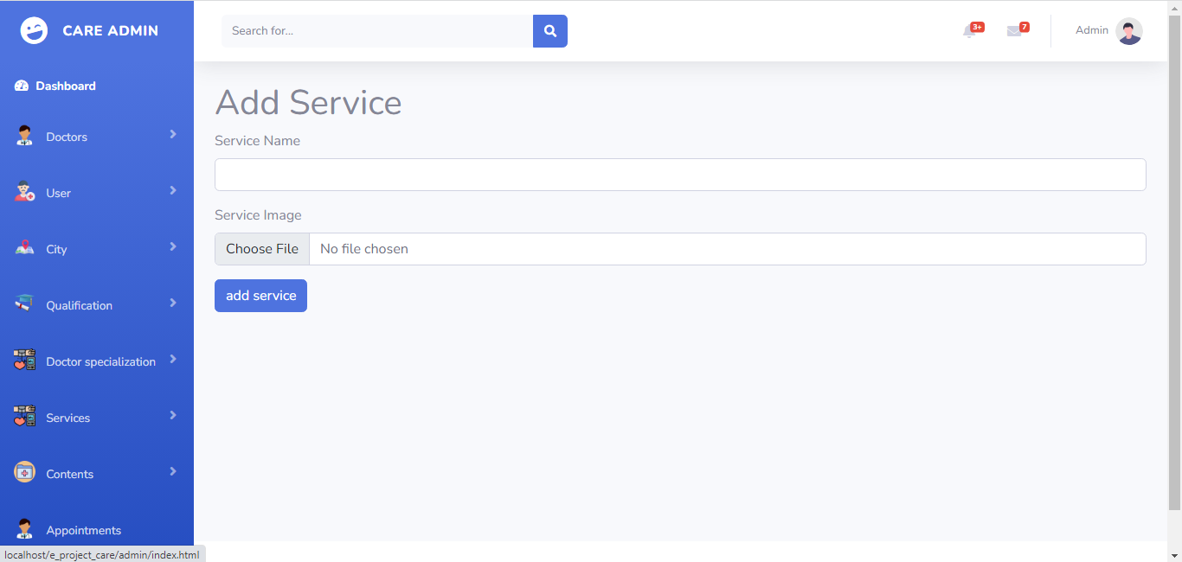
Admin -> Add Service

Slide 8
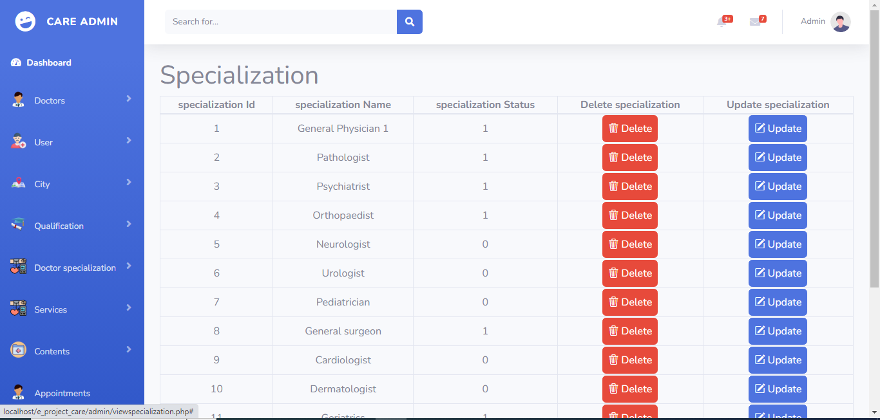
Admin -> Doctor Specialization

Slide 9
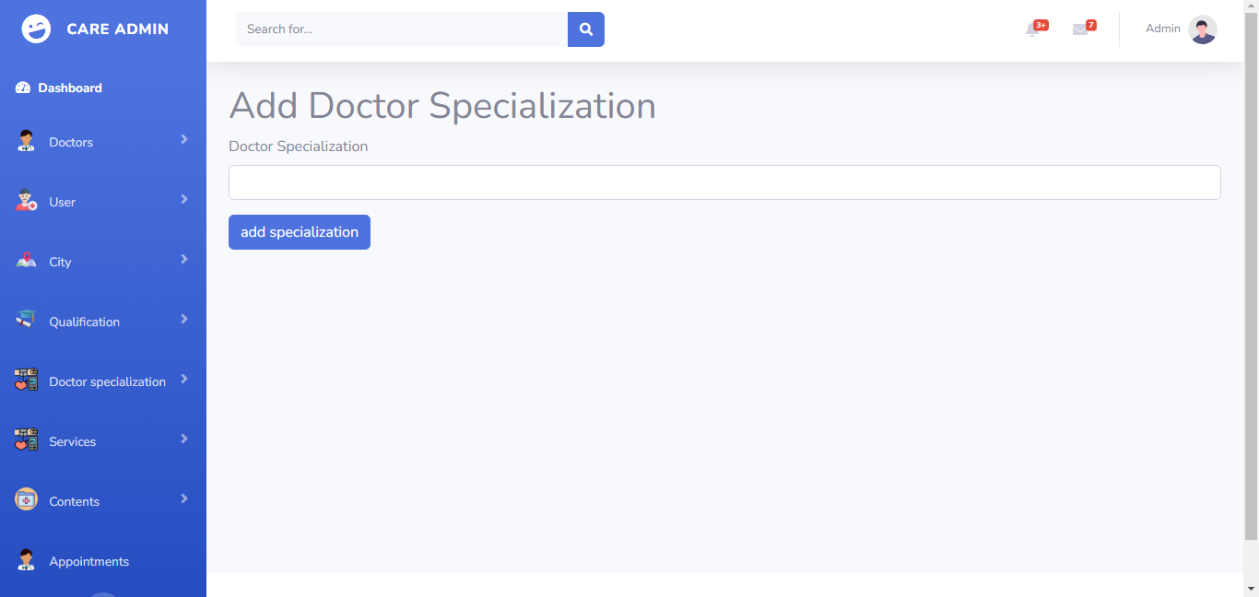
Admin -> Add Specialization

Slide 10
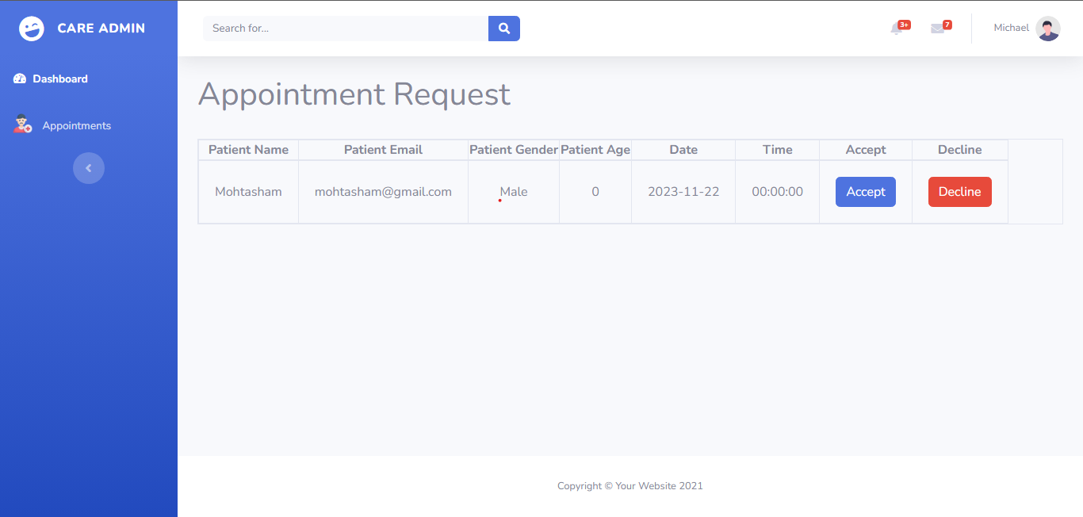
Doctor Panel -> Appointment Request

Slide 11

User Side -> Before Login

Slide 12

User Side -> After Login of User

Slide 13

User Side -> After Login of Doctor

Slide 14
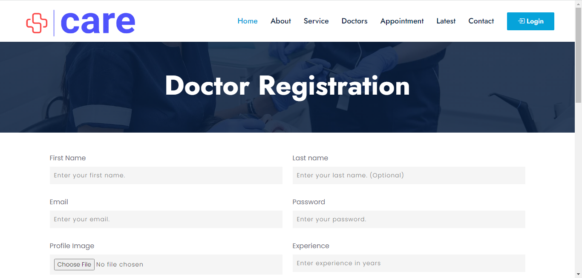
User Side -> Doctor Registration

Slide 15
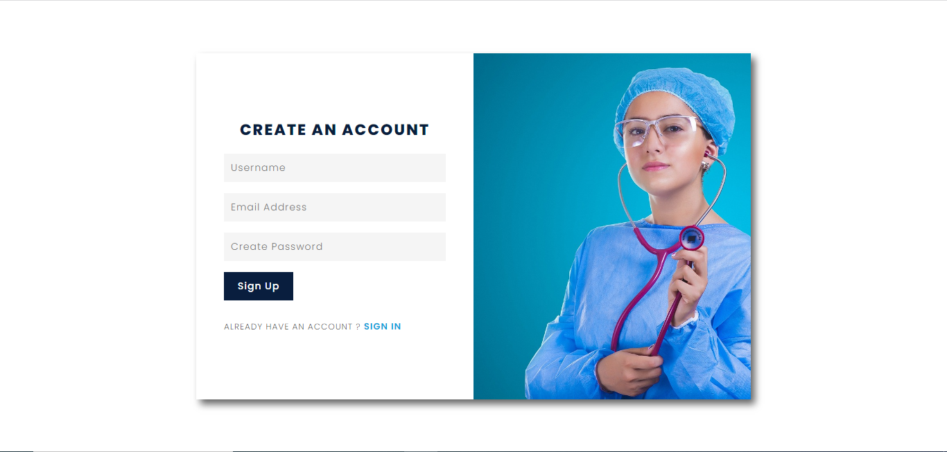
User Side-> Patient Sign Up

Slide 16

User Side -> Our Doctors

Slide 17
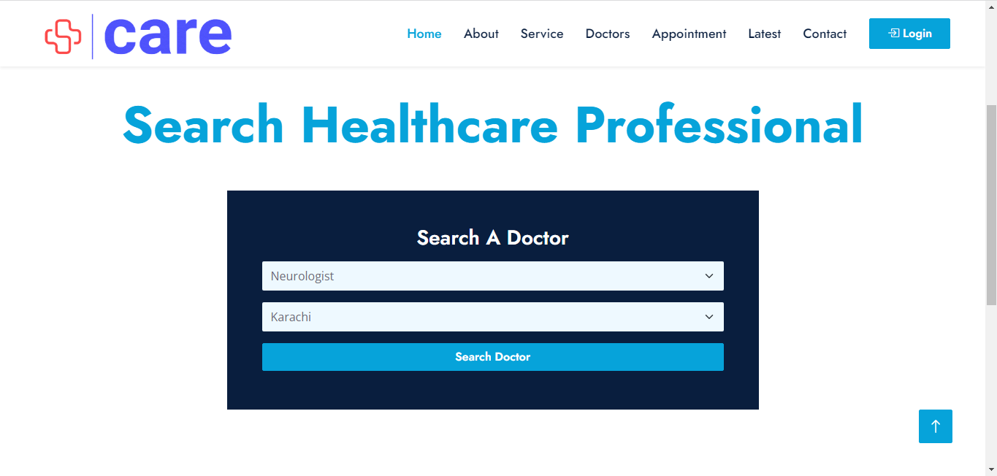
User Side -> Search Doctor

Slide 18
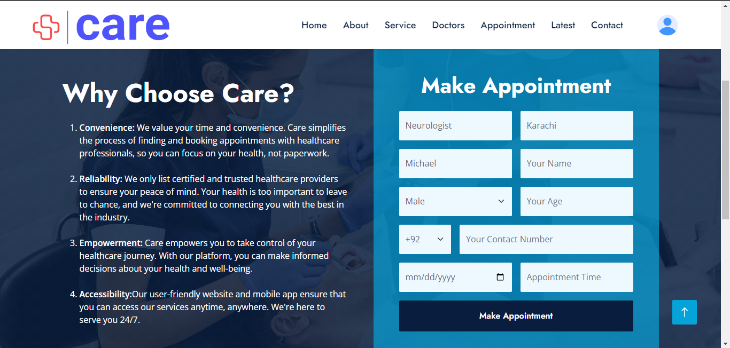
User Side -> Make Appointment

Slide 19
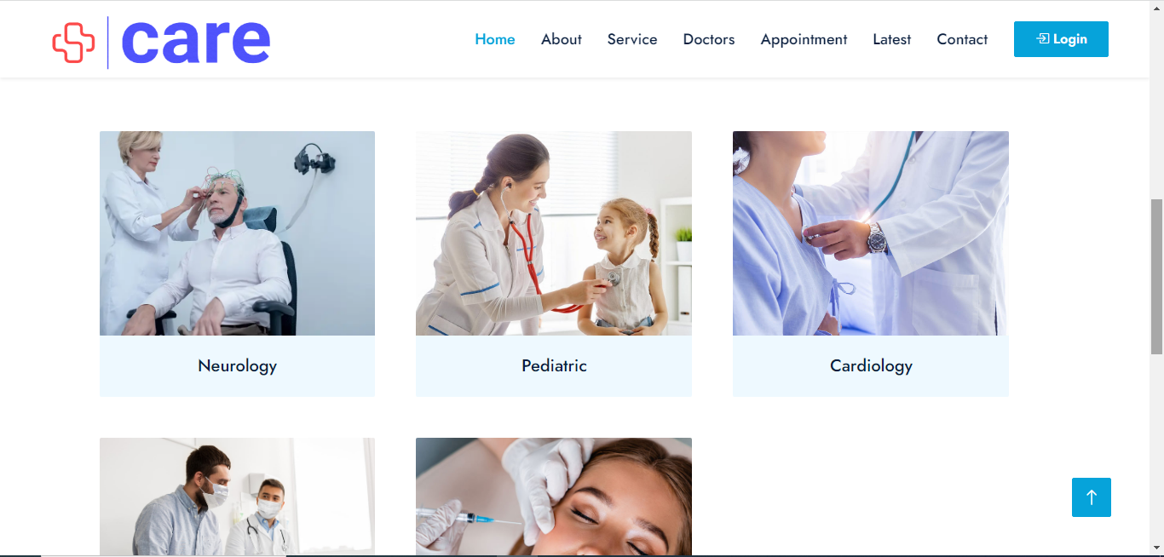
User Side -> Our Services

Slide 20
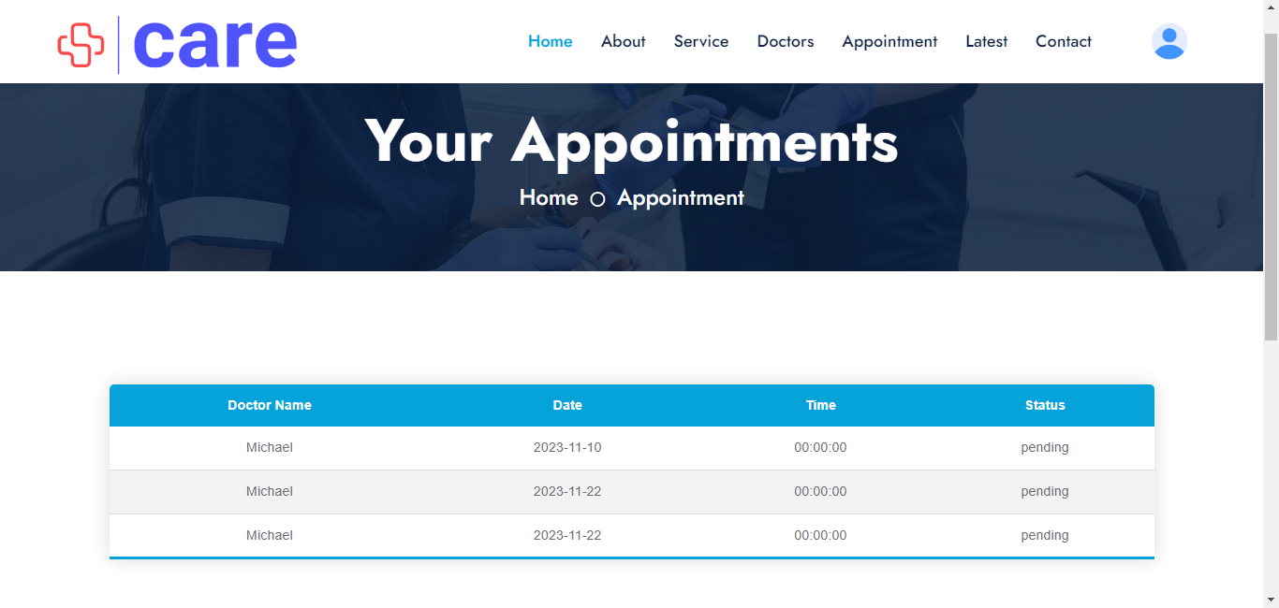
User Side -> Appointment Status

Slide 21
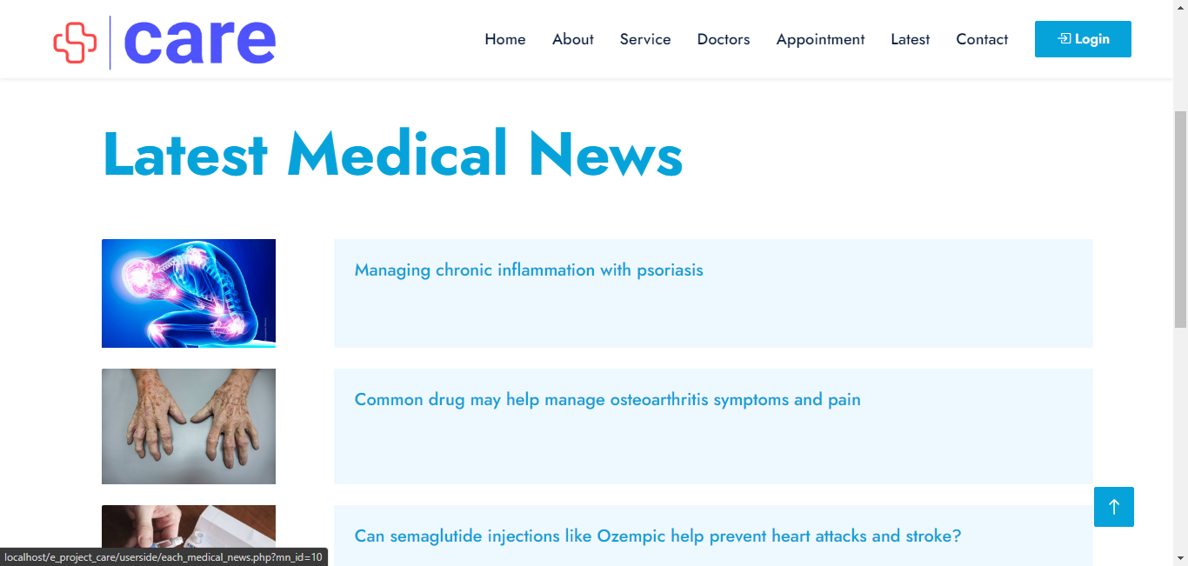
User Side -> Medical News

Slide 22
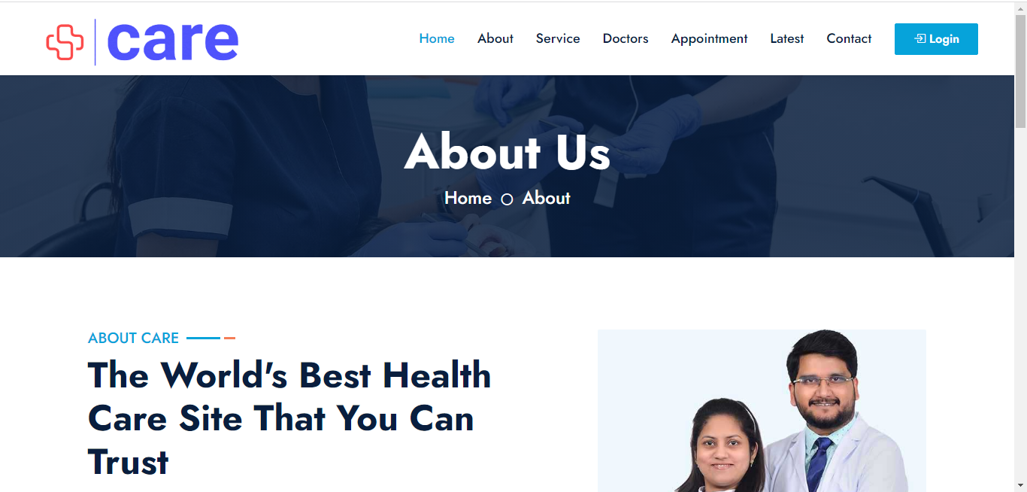
User Side -> About Care

Slide 23
Student Work Division
Muhammad Mohtasham
Student1431527
Home, Politics, Business, Entertainment, Technology, Health & Contact Us
Muhammad Mohtasham designed all the above pages with navbar and footer
Muhammad Fahad
Student1432254
Sports page
Muhammad Hassan designed pages of all sports news and prepared documentation
Mirza Usman
Student1430119
5 different cities & About Us
Astaqim also designed the pages of all the news of 5 different cities

Slide 24
Thanks

